Slide 1
WRITING INSTRUCTIONS
BY
Madiha Rehman
Lecturer

Slide 2
What are the following and what is their purpose?

Slide 3
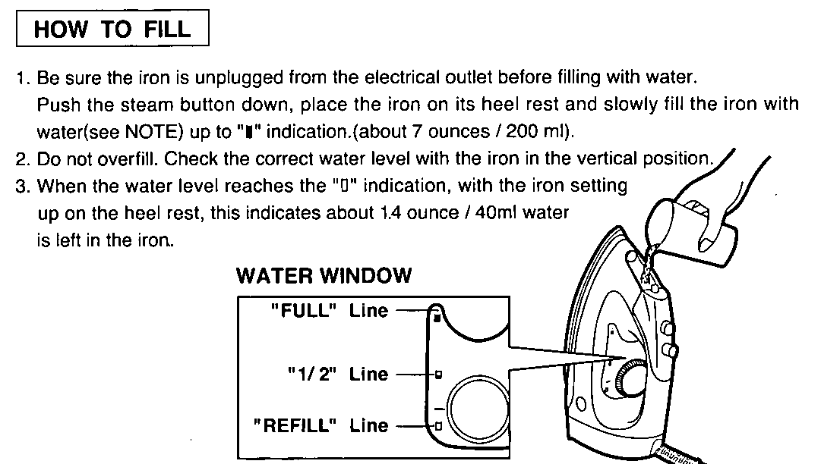

Slide 4
Signing up with Twitter- To create an account on the web:
Go to http://twitter.com and find the sign up box, or go directly to https://twitter.com/signup.
Enter your full name, phone number, and a password.
Click Sign up for Twitter.
In order to verify your phone number, we will send you an SMS text message with a code. Enter the verification code in the box provided. Learn more about having a phone number associated with your account here.
Once you've clicked Sign up for Twitter, you can select a username (usernames are unique identifiers on Twitter) — type your own or choose one we've suggested. We'll tell you if the username you want is available.
Double-check your name, phone number, password, and username.
Click Create my account. You may be asked to complete a Captcha to let us know that you're human.
Note: if you'd like to sign up with Twitter using an email address, you can do so via the "Use email instead" link at the bottom of the sign up page.

Slide 5
Registering an Individual
If you want to register a single student, then this option is used. All courses offered by the department will be shown to the user and he/she can register the student in the required courses.
Select the ‘Student Registration’ link under the ‘Registrations’ subsection.
Enter the roll number in the textbox.
Click the ‘Search Roll No’ button, student information along with the courses list will be shown

Slide 6
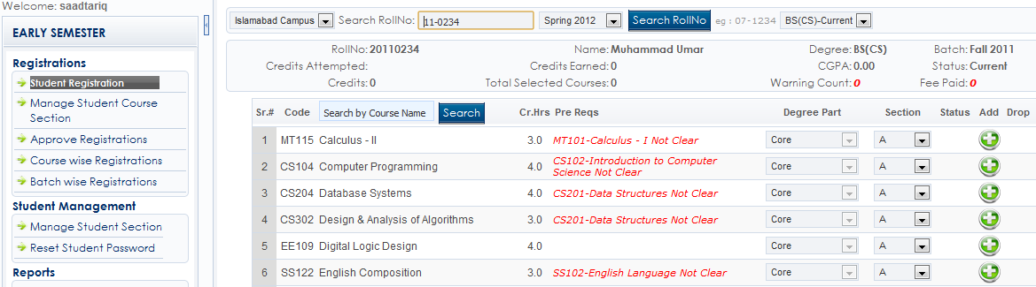

Slide 7
Some technical vocabulary about instructional writing
INSTRUCTIONAL WRITING: It is that writing which gives instructions to readers regarding a well-defined and specific topic.
INSTRUCTIONS: Instructions direct/teach/guide a person to do something, furnish with information needed to accomplish something.
In the context of technical writing, instructions are those step-by-step explanations or guidelines which teach/guide/help/direct users regarding how to do accomplish tasks.

Slide 8
Some technical vocabulary about instructional writing
TASK: A specific piece of work, a distinct specific action/activity
PROCEDURE: It refers to
manner of proceeding; a way of performing or effecting something: standard procedure.
A series of steps taken to accomplish an end: a medical procedure; evacuation procedures.
A set of established forms or methods for conducting the affairs of an organized body such as a business, club, or government.
Computer Science: A set of instructions that performs a specific task; a subroutine or function.

Slide 9
Can you name some documents that contain instructions

Slide 10
Answer
User guides
Manuals
Tutorials
Training videos
All such documents may contain instructions for different tasks, procedures, etc.

Slide 11
Writing Headings for Instructions Written for a Particular Task
Headings should be:
Descriptive and informative.
To the point and simple.
Use positive language.
In software guides, gerunds are more common than “How to..” structure.
Bad | Good
Reports Files Backups | Printing Duplex Reports, Saving XML Files To Shared Networks, Creating and Archiving Backups

Slide 12
Who writes the instructional material?
Technical writer
Programmers
Product or project managers
Engineers
Other technical staff, particularly in smaller companies.

Slide 13
Write instructions on the following
How to create account on Netflix.

Slide 14
There is an important thing you need to bear in mind about readers before you start working on writing instructions for them.
Users usually read the documentation in desperation, after what they tried to do failed.
They're now frustrated, they have messed up things.
They're lost as to how to proceed to complete their goal.

Slide 15
Grammar for Instructional Writing
Present tense
Imperative sentences
Active voice
Short sentences
Precise terms
Sign posts
Numbered lists

Slide 16
How to write instructions to explain the procedure to accomplish a well-defined and distinct task:
Conduct a thorough research on the task and identify all the steps that are followed to complete the procedure. Find all minute details. Visualize the procedure and show this awareness in writing. Work on achieving a technically advanced understanding of the procedure and all the steps. Make a list of all the steps. This is your rough draft.
Identify special requirements, conditions, cautions, warnings, any other vital background information that is needed. Inform the reader about it before beginning to instruct about the task (steps).
After audience analysis decide on the level of detail, organization, style, and vocabulary.

Slide 17
How to write instructions to explain the procedure to accomplish a well-defined and distinct task:
Write a clear heading for the task. Instructions are usually titled as "How to do task ABC", making sure that the instructions under this heading all have to do with accomplishing task ABC (and nothing else).
Use imperative sentences.
Use precise, concrete, and image building verbs. For example,
“Press the emergency button” rather than “Hit the emergency button.”
Always use active voice.
Address the reader directly using the pronoun “you”. Avoid third person pronouns.
Put the steps/commands in chronological order. Enable readers to visualize the procedure.
Explain with the help of graphics.

Slide 18
How to write instructions to explain the procedure to accomplish a well-defined and distinct task:
Use a numbered list when the order is important. Use a bulleted list (like this list) when the order is not important (for example, when the reader can choose between different options).
Specify conditions before the primary part of the instructions. For example, at step 5 of some stocktaking instructions, do not write, "Before you start the stocktake, make sure that…" (This type of problem frequently occurs.)
Avoid lists of more than approximately ten steps. If possible, divide a long list of instructions into two or more different tasks.
Specify what the reader does when the task is complete. If a reader asks, "Now what?", the instructions are not complete.

Slide 19
For software, follow the guidelines given below:
Orient the users: tell the users where they are and what they should be seeing on their screen, such as the name of the window they should be looking at.
Tell them what button(s) to click on the current window and/or what text they need to type into what field(s).
Explain with the help of graphics (screen shots).
Tell them how to get to the next step/location and describe what they should see onscreen when they take that action.
tell the reader where they are→tell them what to do→describe the results of their actions

